Slide 1

Background Check Training and Updates – Q&A
IT Security Information Training – Q&A
Date: June 17th 2021 12pm
Meeting Facilitators:
Adela Gonzalez, Office Administrator
Beatriz Valdez, Deputy Director
Jennifer Almaraz, Project Assistant
Professional Speaker:
Tim Geske, IT Specialist
Chicago Transom Partners

Slide 2
Introductions
Illinois Association of Court Appointed Special Advocates:
Adela Gonzalez, Office Administrator
Beatriz Valdez, Deputy Director
Jennifer Almaraz, Project Assistant
Chicago Transom Partners:
Tim Geske, IT Specialist

Slide 3
Acronyms used for Backgrounds
BGC or BC – Background check
TCN – Transaction Control Number – Receipt from Biometric Impressions once fingerprints are completed.
BC Unit or BCU– DCSF Background check Unit
FP- Fingerprints
DCFS FP Notice Required– DCFS Fingerprint Search letter notice requiring fingerprints – Print and take to Biometric Impressions
DCFS FP Notice Not Required – DCFS Fingerprint Search letter notice notifying that 1st data base search with Biometric Impression found fingerprints on file.
Clearance – DCFS Background check clearance and date confirmation letter.
OOS- Out of State - OOS form Biometric Impressions is required if applicant is a resident of another state (Not Illinois).

Slide 4
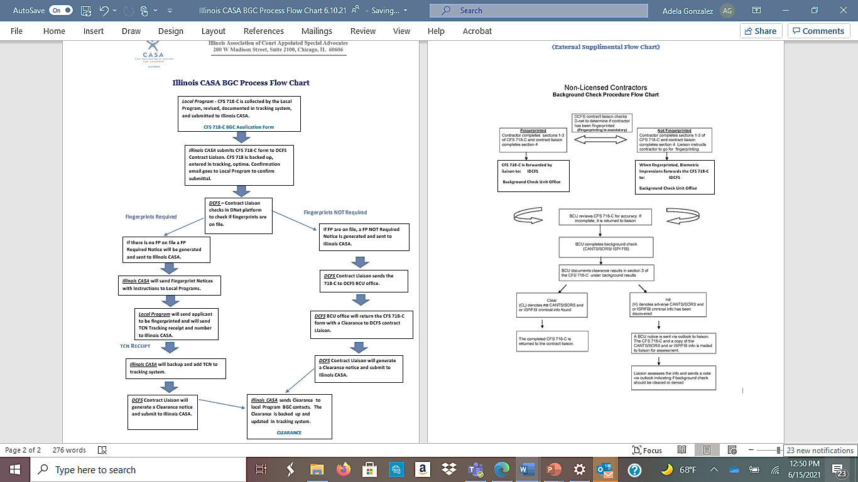
Illinois CASA BGC Internal Process Flow Chart and DCFS Supplemental Flow Chart (Will email to BGC contacts and will upload to Illinois CASA website)

Slide 5

BGC – Reminders
Monthly Inactive list- Please continue to check for monthly inactive volunteer, board members, and staff. Send monthly reports and lists to grants@Illinoiscasa.org. If your program does not have any new inactive volunteers, please email stating there is no new inactive applicants for that month.
CFS 718-C submittals - Please send CFS 718-C forms in individual emails not in a group. If we need to return any of the forms for revisions, we prefer responding to the one inquiry rather than break out items from a group submittal. If the CFS 718 is a revised copy in response to a DCFS notice, please indicate this in the email submission.
Indicate Type of BGC – Staff, Volunteer, Board Member – Please list the type of BGC application when sending the CFS 718-C form. Add this to the Subject or message of the email.

Slide 6
BGC – Reminders
TCN Receipts- Please make sure BGC applicants return the TCN to you after completing the Fingerprints. The TCN receipt number is a tracking number, and the date is the date the applicant completed biometric fingerprints.
If the TCN is in response to a Reprint notice, please indicate ‘TCN Receipt Reprint’ when you email the receipt.
Please add the TCN number and completion date to the subject of the email or in the email message. This information is copied and pasted to the Illinois CASA tracking sheet and Optima.
The DCFS background check unit will not run a Fingerprint tracking search if there is no TCN number. They will not run a search with only an applicant name. They require a TCN number for follow up and tracking requests.
Our goal is to have the applicants return a TCN receipt within a week of your program receiving the FP search notice (Ideal time frame).

Slide 7
BGC - Reminders
Labels and email Subject- Please use the recommended labeling/naming convention for emails and documents. This helps us process the BGC items quickly. Please add the applicant or type of inquiry label in the email subject line for better email tracking.
CFS 718-C Checklist – We ask that all programs check each CFS 718-C form for missing, illegible, or needed revisions. We have provided a CFS 718-C check list to all BGC programs. This is also found on the Illinois CASA website under Training/Background Check.
We want to avoid DCFS revision notices or returned forms. These steps add time to the BGC processing.
Check that legal names are used on the CFS 718-C forms. If the document label or form is a nickname (not the legal name), the BGC application will be prolonged, and an identity verification will be requested by DCFS.
Please make sure you are using the applicant's full legal name for submittals, inquiries, tracking, and document labels. Accurate and correct spelling of applicant’s name also impacts background check processing and tracking.
Make sure the applicants are signing the CFS 718-C form and not initialing. No e-signatures are currently accepted by DCFS.

Slide 8
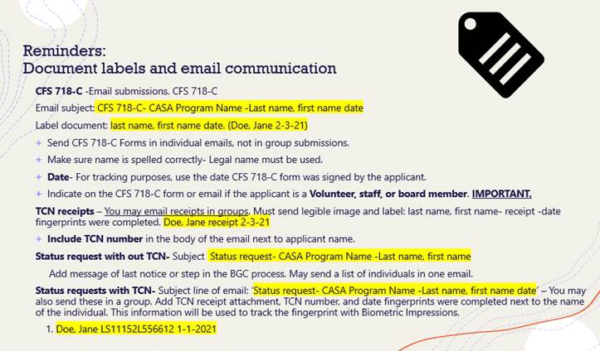
Email and Document Labels

Slide 9
BGC Process and Response Time
We ask for your patience as we work through email inquiries. Illinois CASA BGC personnel will work through email inquiries and will respond typically within 1 week after an item is processed. (Keep in mind that there might be a backlog at times and response time from Illinois CASA could be up to 2 weeks.)
The encryption steps have added time to the BGC processing, both for DCFS and Illinois CASA. We ask for your patience and understanding as we work through our own backlog and address status requests for items pending over a month.
If there longer response time or a backlog, either for Illinois CASA or DCSF, we will email updates to the Background check contact distribution list.
Please email grants@illinoiscasa.org for requests to change/or add BGC contacts for the Program Contact list and/or BGC email distribution list. You may specify who is the main contact and if anyone should be copied in communication.

Slide 10
‘Status Request’: Submittals and tracking questions
If you are submitting a status request for an application, please use the words ‘Status Request’ in the email subject line. This will help us prioritize the inquiries.
When sending status requests, please specify what step of the process you are inquiring about.
Examples:
CFS 718-C Form submittal – (longer than week from submittal date with no confirmation of processing)
Fingerprint search notice not received yet. (longer than week from submittal date)
TCN tracking request– add the TCN number and attachment. Note that you are checking status on the Fingerprints. (1 month of TCN completion date)
Reprint TCN tracking – Follow same as TCN Tracking Request.

Slide 11
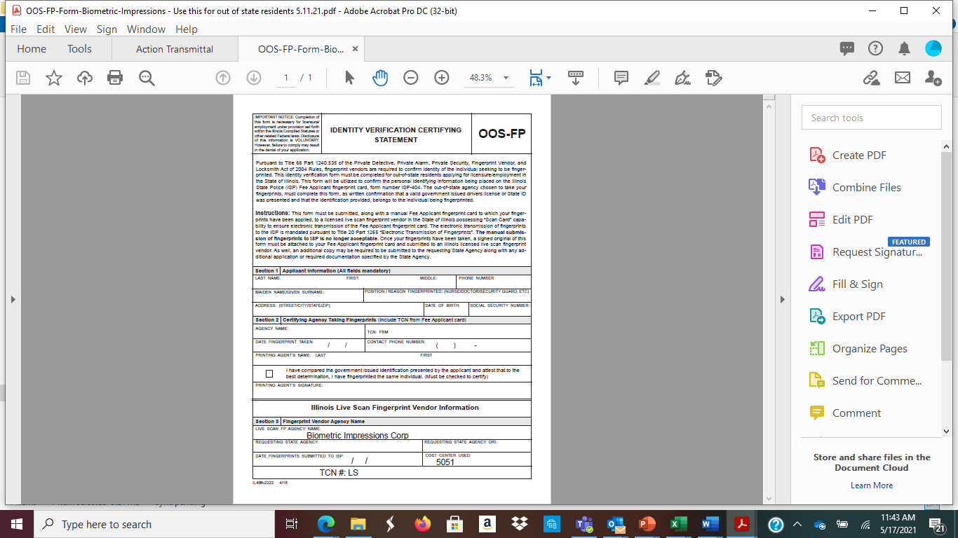
Update:
Out of State Residence BGC – OOS- FP Biometric Impression Form
If you have a BGC applicant who is an out of state resident, who will be fingerprinting in Illinois, please use the OOS –FP form found on the Biometric Impression website. Form also found on the Illinois CASA website under Trainings/ Background checks.
Please collect the OOS- FP form and submit with CFS 718-C submittal. Applicant should read instructions and fill out section 1. When you submit the CFS 718-C form to Illinois CASA for out of state residents, you must include the Biometric OOS – FP form for DCFS to create a FP search notice specifically for this application. This will avoid BGC delays and prolonged time to the application process.

Slide 12
DCFS Expiration Rules
1 week applicant response time- Please ask applicants to respond within a week of the date the local program receives DCFS Notices.
1 Month Rule- DCFS Notices must be responded to within a month of the notice date to avoid applications from being canceled. (The communication between DCFS, Illinois CASA, Local Program, and the applicant should all be done within a month.)
This rule applies to the following DCFS Notices:
Fingerprint Search Notices
Reprint Notices
Revision and Identity Verification Notices
6 Month Rule – The CFS 718-C application form will expire 6-months from the signature date.

Slide 13
‘Expired’ CFS 718-C forms and submittals
If an application has expired due to the 6-month rule or date. We ask that you resubmit a new CFS 718-C form and indicate in the email that it is a continuation to an ‘Expired’ application.
If you use the label or word ‘Expired’ within the message of the email or subject, we will recognize that there was a previous application in process for that same applicant.
A new fingerprint search notice will be generated for continuation of expired CFS 718-C applications. Please do not use the old Fingerprint notices.

Slide 14
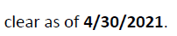
2 Year BGC Expiration – ‘Clearance Renewals’
The BGC Clearance expires 2 years from the clearance date in the DCFS letter.
Local Programs are expected to track background checks for staff/volunteers/board members and make sure to submit the clearance ‘renewals’ at least 2 -3 months before renewal date expiration.
When submitting new CFS 718-C forms to grants@illinoiscasa.org , please indicate ‘clearance renewal‘ in the subject line.

Slide 15
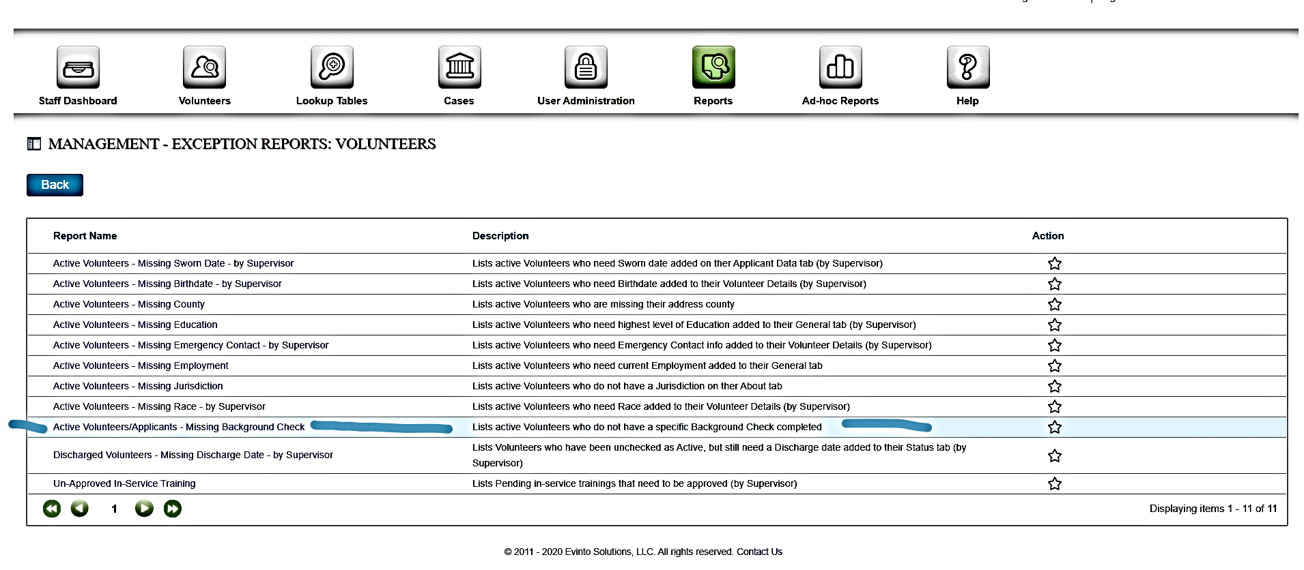
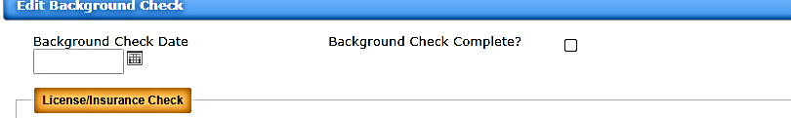


Missing Background Check Optima Report
During the 2/3/2021 training we went over how to run reports in Optima for inactive volunteers and missing clearance.
When entering clearance dates in Optima, make sure you are marking both the clearance box and clearance date. If you are not doing this step with clearances, the ‘Missing Background check’ Optima report will not pickup the correct missing BGC applicants.

Slide 16
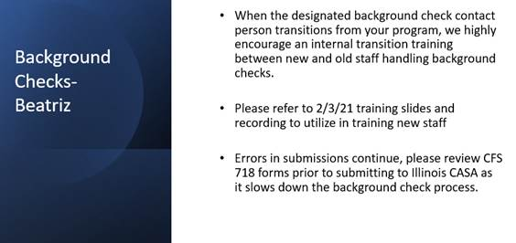
4/8/21 Slide Network Call

Slide 17
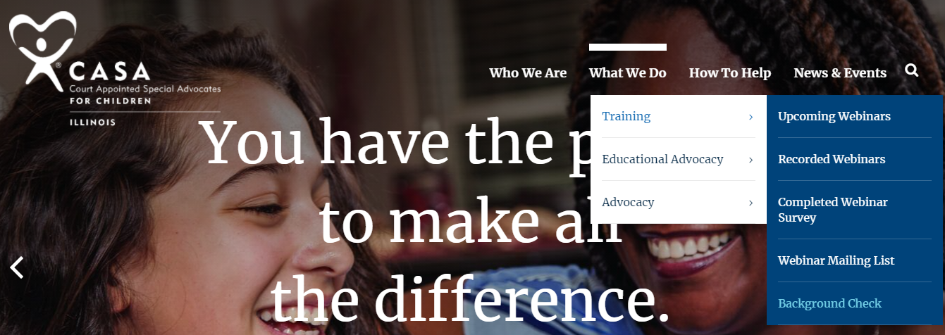
CFS 718-C Checklist and BGC Training Material
Please use the CFS 718-C checklist and make sure all items are filled out completely and clear before sending CFS 718-C BGC application to Illinois CASA .
Utilize the background check training material posted to the Illinois CASA website, under -What we do, Training, and Background Check.
This section of the Illinois Website will be used to upload updated training material and BGC forms.

Slide 18
Final Reminders
All programs are expected to encrypt and/or secure their background check information in order to protect the confidential information of our volunteers (i.e. electronic and physical information)
All programs are expected to have an internal background check process/system
All volunteers, staff and board members are required to undergo the background check process through Illinois CASA/DCFS.

Slide 19
Background Check - Q&A
Thank you for all your hard work! We appreciate you communicating and reaching out to Illinois CASA for assistance.
We value your hard work processing Background checks and responding in a timely fashion.

Slide 20
IT Security and Encryption
Tim Geske, IT Specialist
Chicago Transom Partners
Email Security
Email Reputation has big impact on delivery of emails.
  SPF, DMARC, DKIM DNS records
  Test your domain at https://dnschecker.org/domain-health-checker.php

Slide 21
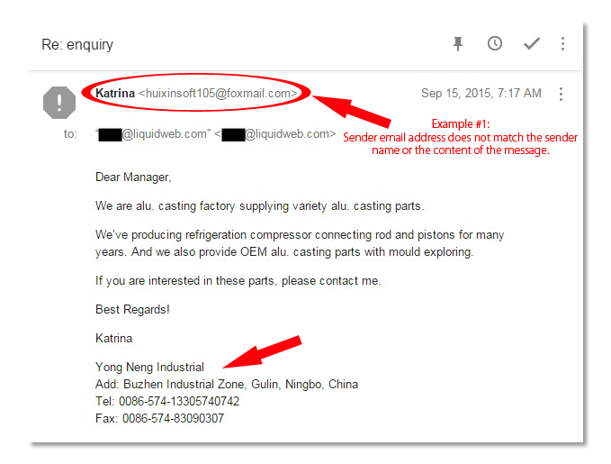
IT Security and Encryption
Tim Geske, IT Specialist
Chicago Transom Partners
What is a spoofed email?

Slide 22
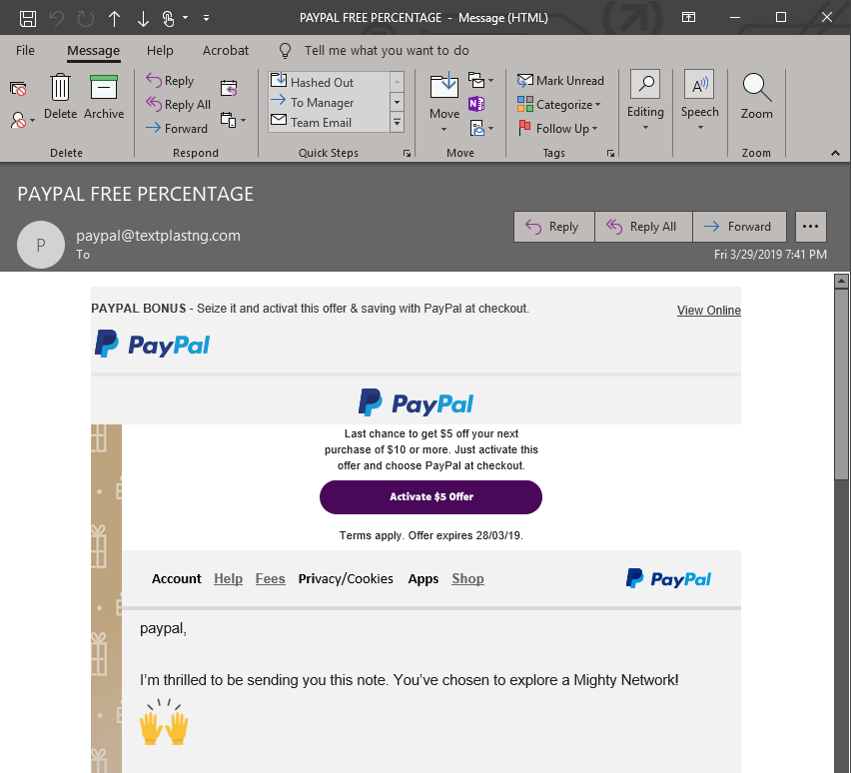
IT Security and Encryption
Tim Geske, IT Specialist
Chicago Transom Partners
What is a phishing email?

Slide 23
IT Security and Encryption
Tim Geske, IT Specialist
Chicago Transom Partners
User education/training is most IMPORTANT part
https://phishingquiz.withgoogle.com/

Slide 24
IT Security and Encryption
Tim Geske, IT Specialist
Chicago Transom Partners
Email encryption
  If you are emailing PII (personal identifible informaiton [SSN, DOB, etc]) YOU are responsible for securing said email (this falls onto sender and not receiver)
  Google Workspace
    Virtu
  Microsoft 365
    Native/builtin encryption
    Virtu (or others)

Slide 25
IT Security and Encryption
Q&A
Poll – Virtru
Feedback- Challenges – Questions and Comments

